Slide 1

Vehicle Sales Data Analysis
PRESENTED BY:
Athira Sooraj

Slide 2

Exploratory Data Analysis

Slide 3
Key Data Anomalies
Missing Values | Outliers | Incrorrect Data | Duplicates
The data had a total of 2,224 missing datapoints. SIAM Segment 1: 12 missing values SIAM Fuel: 18 missing values Category: 1097 missing values Category Name: 1097 missing values The missing values are handled and the data is cleaned. | High values of outliers detected in Production Qty, Domestic Sale and Export Sales Production Qty: 3,082 outliers Domestic Sales: 2,830 outliers Export Sales: 4,760 outliers The large number of outliers is due to significant number of 0 values | Production Qty and Domestic Sale data contained negative values which were assumed to be positive. Found that total Production Qty is less than Total Sales which could be attributed to already existing inventory. | No duplicates were found in the data

Slide 4
Summary Statistics
 | Production Qty | Domestic Sales | Export Sales
Sum | 2,48,30,976 | 2,21,54,205 | 46,91,081
Mean | 1,263 | 1,127 | 239
Standard Deviation | 2,958 | 2,667 | 963
Min | 0 | 0 | 0
1st Quartile | 0 | 0 | 0
2nd Quartile | 35 | 77 | 0
3rd Quartile | 951 | 866 | 1
Max | 33,128 | 30,499 | 15,088

Slide 5
Key Insights

Slide 6
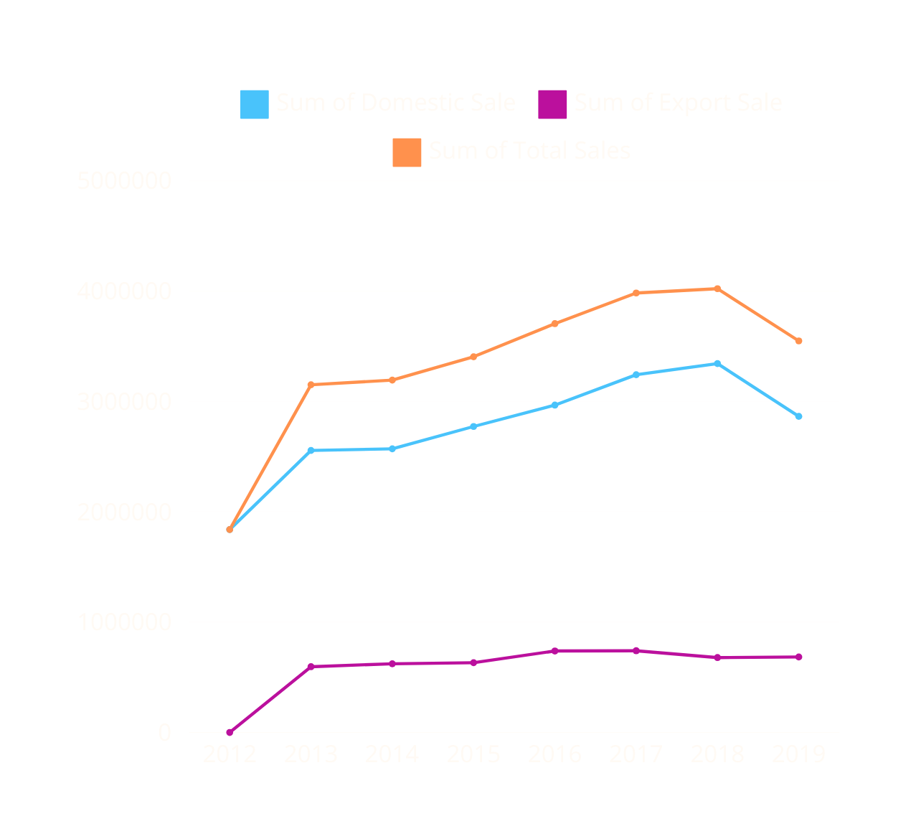

01
While export sales have remained fairly consistent throughout the years, domestic sales shows a gradual increase till 2018 followed by a 14.31% dip in 2019

Slide 7
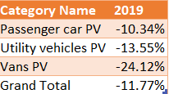
02
Total sales have declined in 2019 by 11.77%. Sales for vans have been most affected with a 24.12% decline, followed by utility vehicles with a 13.55% decline and passenger vehicles with a 10.34% decline.

Slide 8
03
Share of LPG driven vehicles in total sales volume shows a drastic decline from 99.4% in 2012 to 0% in 2019

Slide 9
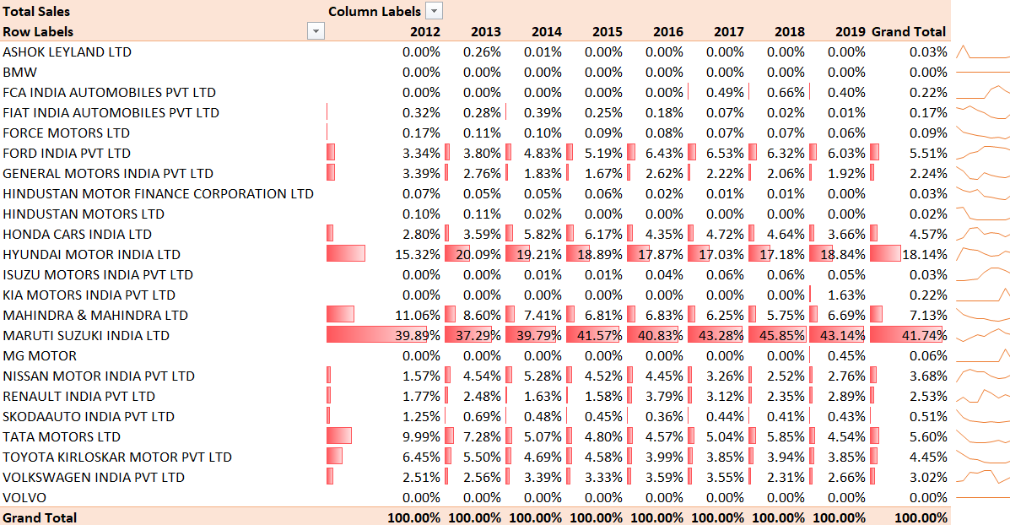
04
Maruti Suzuki India Ltd holds the highest market share in total sales volume throughout the period with an increasing trend.

Slide 10
05
The peak season for sale of vehicles is in October while the dull season is in January

Slide 11
Category wise Sales Forecast for the next 6 Months

Slide 12

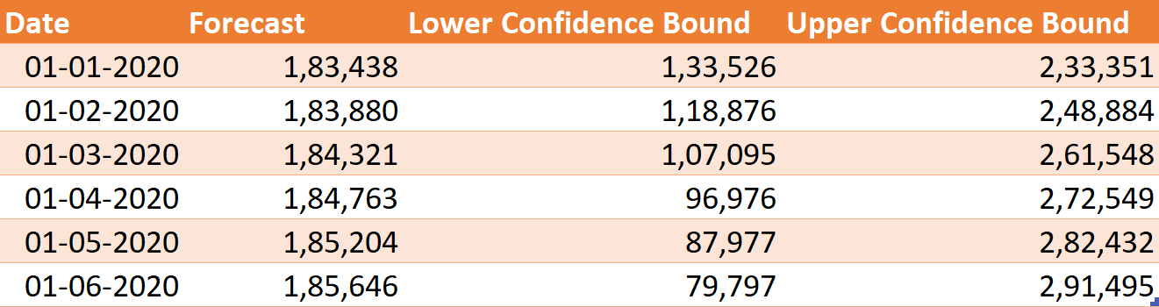
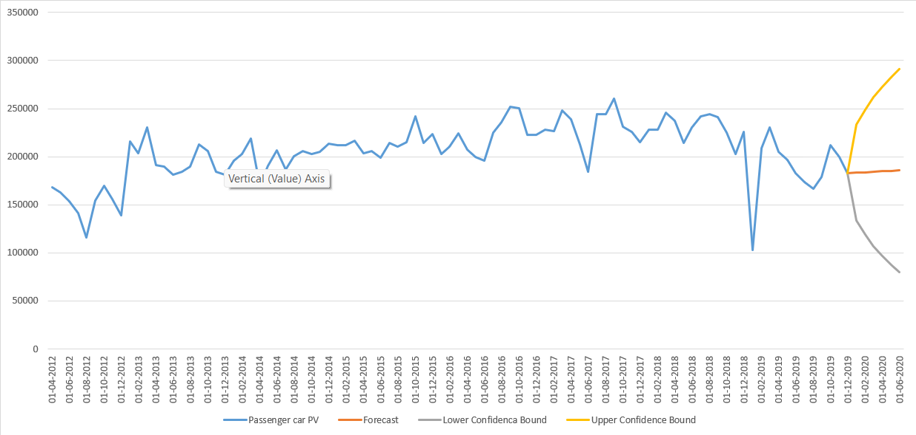
01
Passenger Vehicles

Slide 13
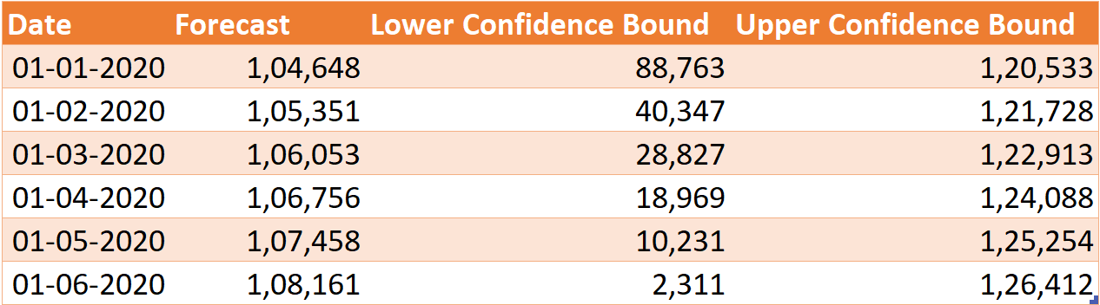
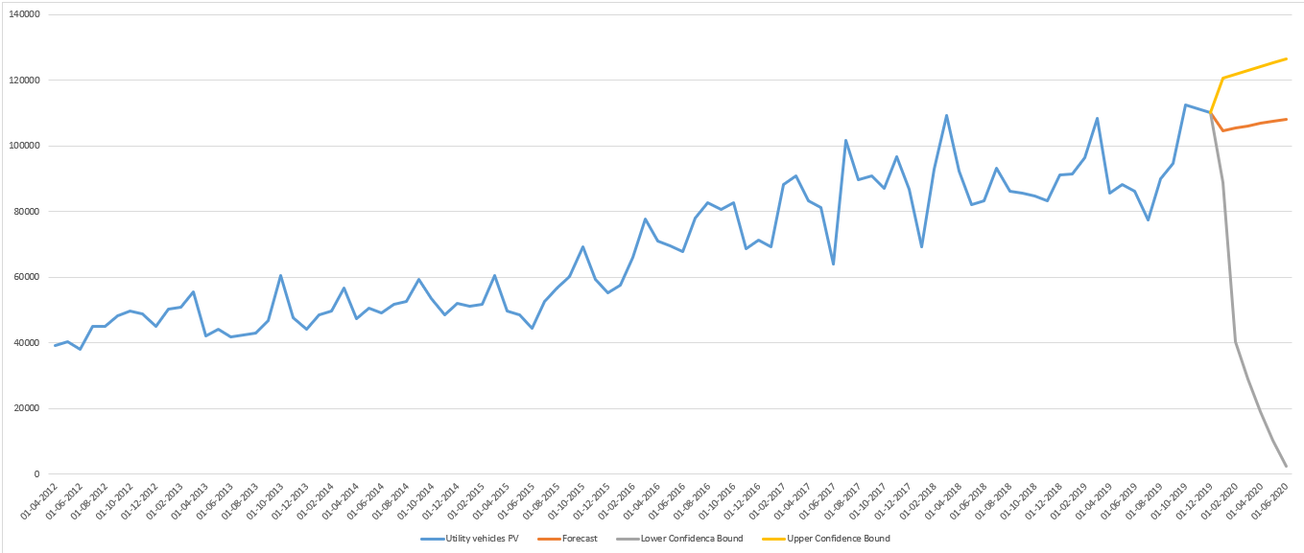
02
Utility Vehicles
01

Slide 14
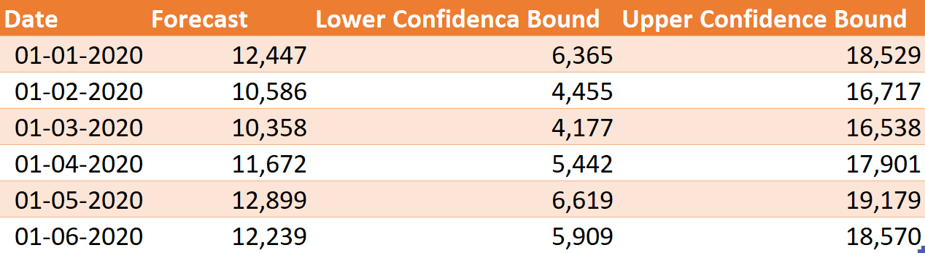
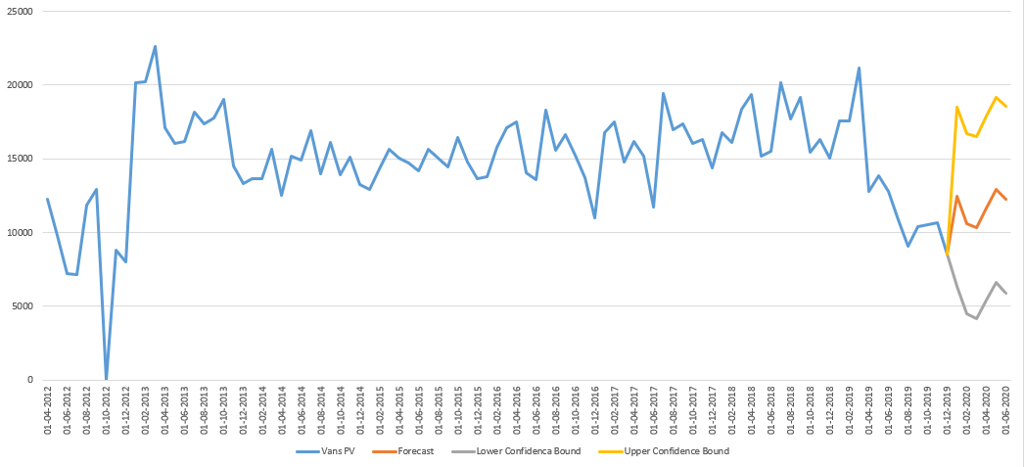
03
Vans

Slide 15
Thank You
PRESENTED BY:
Athira Sooraj

